Slide 1
MATHEMATICAL FOUNDATION FOR COMPUTER SCIENCE
Prepared by: Er. Ankit Kharel
Nepal college of information technology

Slide 2
Recurrence relations
Solution of Linear Homogeneous Recursive Relation

Slide 3
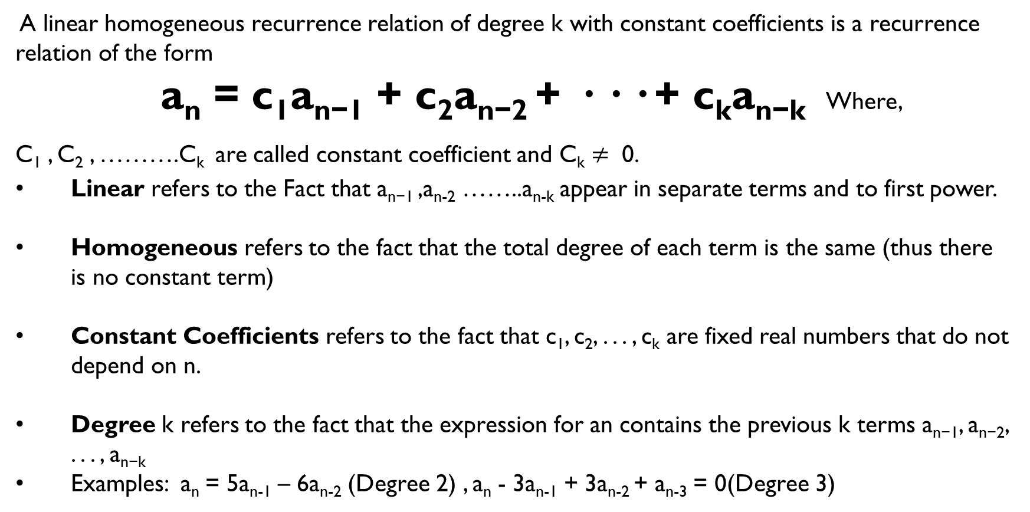
Linear homogeneous recurrence relation:
A linear homogeneous recurrence relation of degree k with constant coefficients is a recurrence relation of the form
a_{n} = c₁a_{n−1} + c₂a_{n−2} + · · · + c_{k}a_{n−k} Where,
C₁ , C₂ , ……….C_{k} are called constant coefficient and C_{k} $≠$ 0.
Linear refers to the Fact that a_{n−1} ,a_{n-2} ……..a_{n-k} appear in separate terms and to first power.
Homogeneous refers to the fact that the total degree of each term is the same (thus there is no constant term)
Constant Coefficients refers to the fact that c₁, c₂, . . . , c_{k} are fixed real numbers that do not depend on n.
Degree k refers to the fact that the expression for an contains the previous k terms a_{n−1}, a_{n−2}, . . . , a_{n−k}
Examples: a_{n} = 5a_{n-1} – 6a_{n-2} (Degree 2) , a_{n} - 3a_{n-1} + 3a_{n-2} + a_{n-3} = 0(Degree 3)

Slide 4
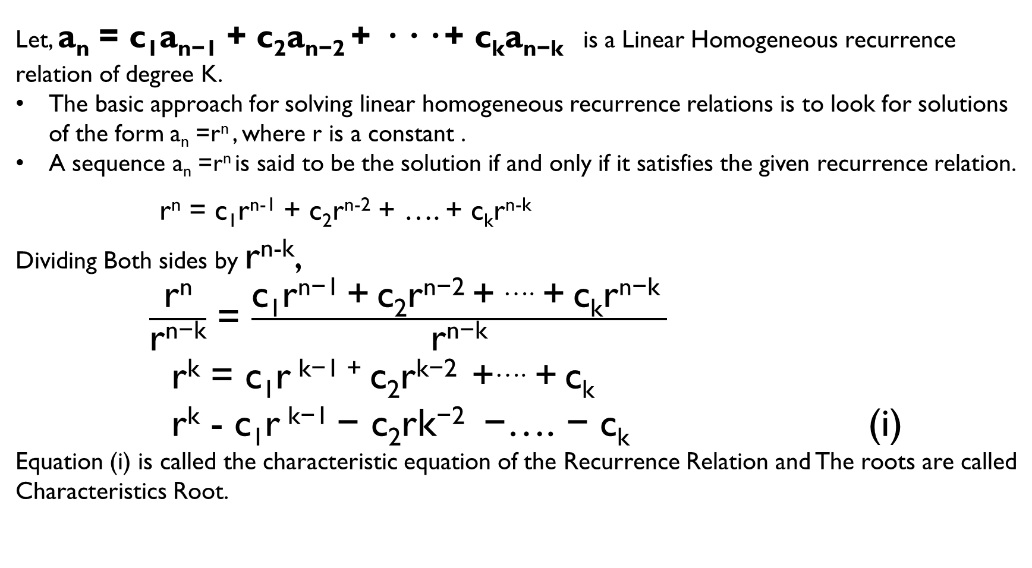
Solution of Linear homogeneous recurrence relation:
Let, a_{n} = c₁a_{n−1} + c₂a_{n−2} + · · · + c_{k}a_{n−k} is a Linear Homogeneous recurrence relation of degree K.
The basic approach for solving linear homogeneous recurrence relations is to look for solutions of the form a_{n} =r^{n} , where r is a constant .
A sequence a_{n} =r^{n} is said to be the solution if and only if it satisfies the given recurrence relation.
r^{n} = c₁r^{n-1} + c₂r^{n-2} + …. + c_{k}r^{n-k}
Dividing Both sides by r^{n-k},
$\frac{\text{r}\text{n}}{\text{r}\text{n}\text{−}\text{k}}$ = $\frac{\text{c}\text{1}\text{r}\text{n}\text{−1 + }\text{c}\text{2}\text{r}\text{n}\text{−2 + }\text{…. + }\text{c}\text{k}\text{r}\text{n}\text{−}\text{k} }{\text{r}\text{n}\text{−}\text{k}}$
r^{k} = $\text{c}\text{1}\text{r} \text{k}\text{−1 + }\text{c}\text{2}\text{r}\text{k}\text{−2 +…}\text{. + }\text{c}\text{k}$
r^{k} - $\text{c}\text{1}\text{r} \text{k}\text{−}\text{1} \text{− }\text{c}\text{2}\text{rk}\text{−2 } \text{−}\text{…. }\text{−} \text{ck}$ (i)
Equation (i) is called the characteristic equation of the Recurrence Relation and The roots are called
Characteristics Root.

Slide 5
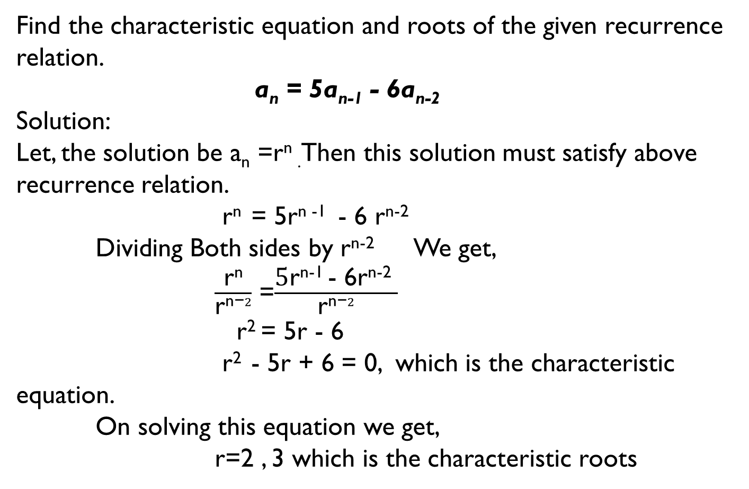
Solution of Linear homogeneous recurrence relation:
Find the characteristic equation and roots of the given recurrence relation.
a_{n} = 5a_{n-1} - 6a_{n-2}
Solution:
Let, the solution be a_{n} =r^{n} .Then this solution must satisfy above recurrence relation.
r^{n} = 5r^{n -1} - 6 r^{n-2}
Dividing Both sides by r^{n-2} We get,
$\frac{\text{r}\text{n}}{\text{r}\text{n}\text{−}2}$ =$\frac{\text{5}\text{r}\text{n}\text{−1 }\text{− 6}\text{rn}\text{−2 }}{\text{r}\text{n}\text{−}2}$
r² = 5r - 6
r² - 5r + 6 = 0, which is the characteristic equation.
On solving this equation we get,
r=2 , 3 which is the characteristic roots

Slide 6

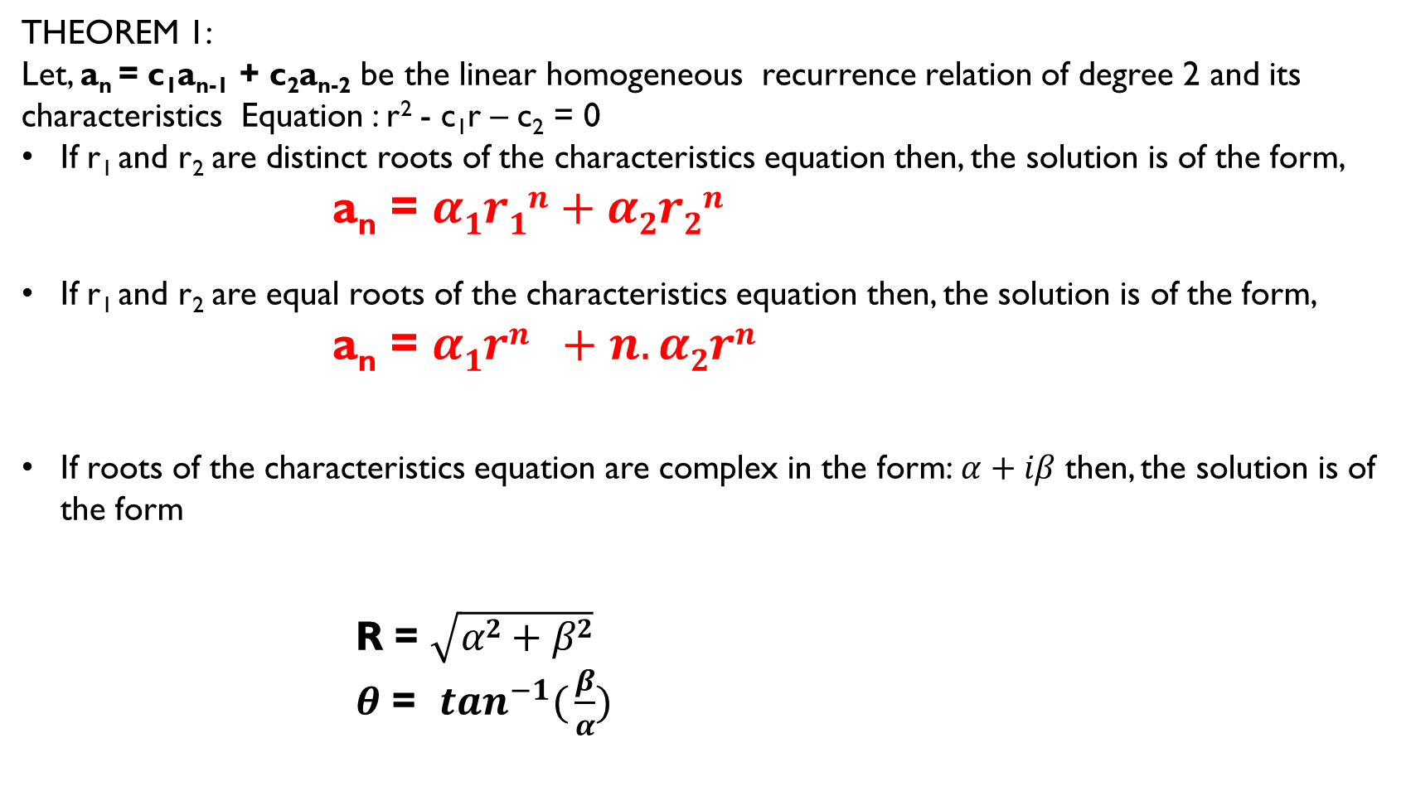
Solution of Linear homogeneous recurrence relation:
THEOREM 1:
Let, a_{n} = c₁a_{n-1} + c₂a_{n-2} be the linear homogeneous recurrence relation of degree 2 and its characteristics Equation : r² - c₁r – c₂ = 0
If r₁ and r₂ are distinct roots of the characteristics equation then, the solution is of the form,
a_{n} = $α1r1n+α2r2n$
If r₁ and r₂ are equal roots of the characteristics equation then, the solution is of the form,
a_{n} = $α1rn +n.α2rn$
If roots of the characteristics equation are complex in the form:$α+iβ$ then, the solution is of the form
R = $\sqrt{α2+β2}$
$θ$ = $\tan^{−1}({\frac{β}{α})}$

Slide 7
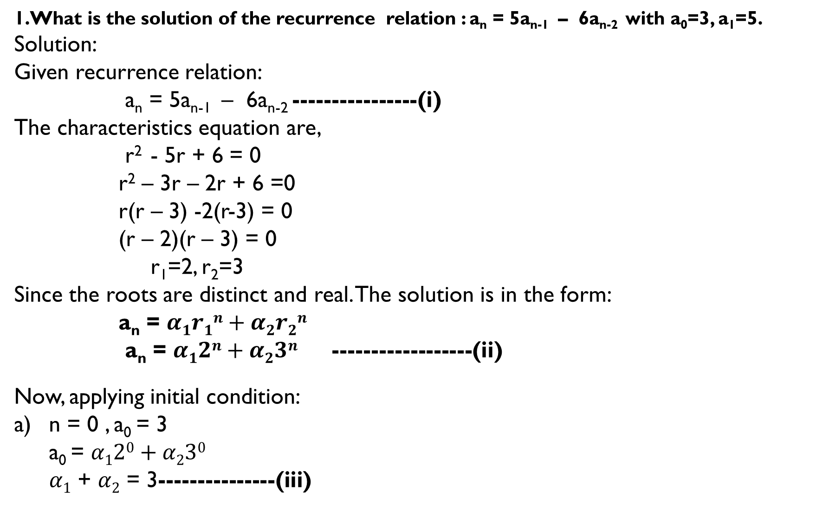
1.What is the solution of the recurrence relation : a_{n} = 5a_{n-1} – 6a_{n-2} with a₀=3, a₁=5.
Solution:
Given recurrence relation:
a_{n} = 5a_{n-1} – 6a_{n-2} ----------------(i)
The characteristics equation are,
r² - 5r + 6 = 0
r² – 3r – 2r + 6 =0
r(r – 3) -2(r-3) = 0
(r – 2)(r – 3) = 0
r₁=2, r₂=3
Since the roots are distinct and real. The solution is in the form:
a_{n} = $α1r1n+α2r2n$
a_{n} = $α12n+α23n$ ------------------(ii)
Now, applying initial condition:
n = 0 , a₀ = 3
a₀ = $α120+α230$
$α1$ + $α2$ = 3---------------(iii)

Slide 8
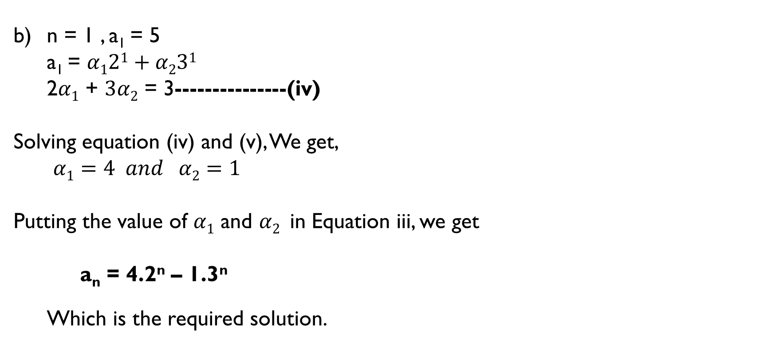
b) n = 1 , a₁ = 5
a₁ = $α121+α231$
2$α1$ + $3α2$ = 3---------------(iv)
Solving equation (iv) and (v), We get,
$α1=4 and α2=1$
Putting the value of $α1$ and $α2$in Equation iii, we get
a_{n} = 4.2^{n} – 1.3^{n}
Which is the required solution.

Slide 9
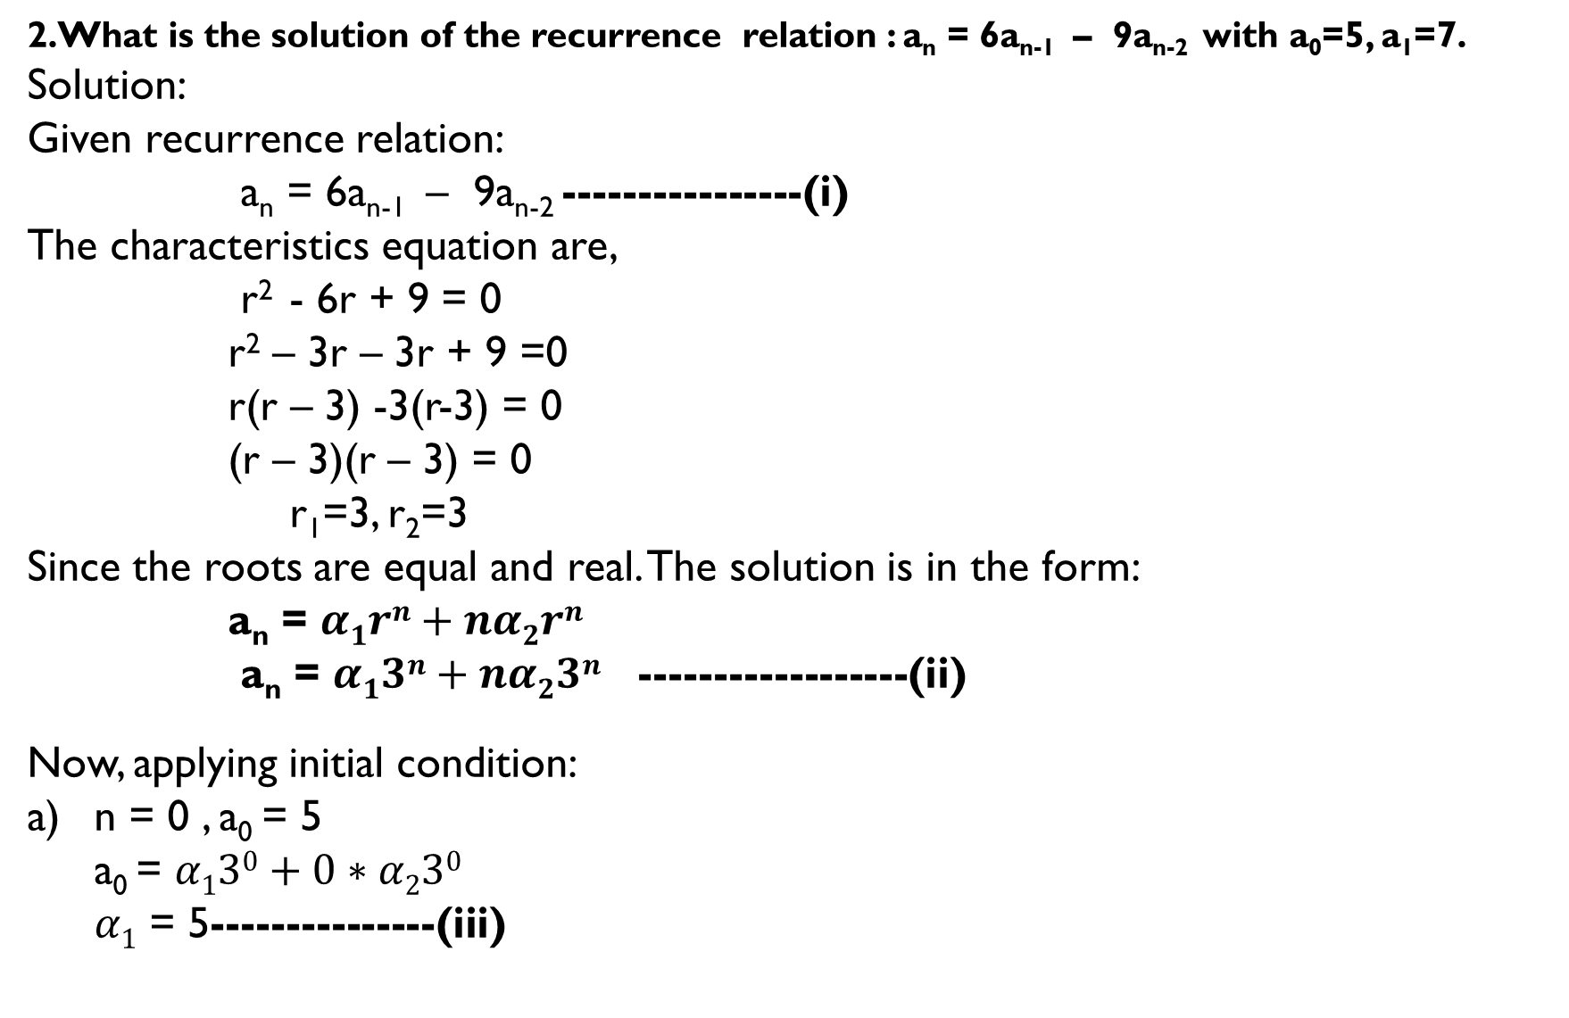
2.What is the solution of the recurrence relation : a_{n} = 6a_{n-1} – 9a_{n-2} with a₀=5, a₁=7.
Solution:
Given recurrence relation:
a_{n} = 6a_{n-1} – 9a_{n-2} ----------------(i)
The characteristics equation are,
r² - 6r + 9 = 0
r² – 3r – 3r + 9 =0
r(r – 3) -3(r-3) = 0
(r – 3)(r – 3) = 0
r₁=3, r₂=3
Since the roots are equal and real. The solution is in the form:
a_{n} = $α1rn+nα2rn$
a_{n} = $α13n+nα23n$ ------------------(ii)
Now, applying initial condition:
n = 0 , a₀ = 5
a₀ = $α130+0∗α230$
$α1$ = 5---------------(iii)

Slide 10

b) n = 1 , a₁ = 7
a₁ = $α131+1∗α231$
3$α1$ + $3α2$ = 7---------------(iv)
Solving equation (iv) and (v), We get,
$α1=5 and α2= \frac{−8}{3}$
Putting the value of $α1$ and $α2$in Equation iii, we get
a_{n} = 5.3^{n} – n$\frac{8}{3}$.3^{n}
Which is the required solution.

Slide 11
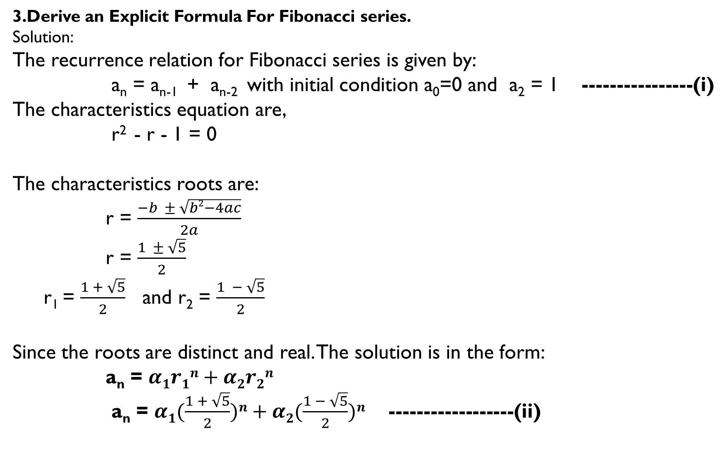
3.Derive an Explicit Formula For Fibonacci series.
Solution:
The recurrence relation for Fibonacci series is given by:
a_{n} = a_{n-1} + a_{n-2} with initial condition a₀=0 and a₂ = 1 ----------------(i)
The characteristics equation are,
r² - r - 1 = 0
The characteristics roots are:
r = $\frac{−b ± \sqrt{b2−4ac}}{2a}$
r = $\frac{1 ± \sqrt{5}}{2}$
r₁ = $\frac{1 + \sqrt{5}}{2}$ and r₂ = $\frac{1 − \sqrt{5}}{2}$
Since the roots are distinct and real. The solution is in the form:
a_{n} = $α1r1n+α2r2n$
a_{n} = $α1(\frac{1 + \sqrt{5}}{2})n+α2(\frac{1 − \sqrt{5}}{2})n$ ------------------(ii)

Slide 12
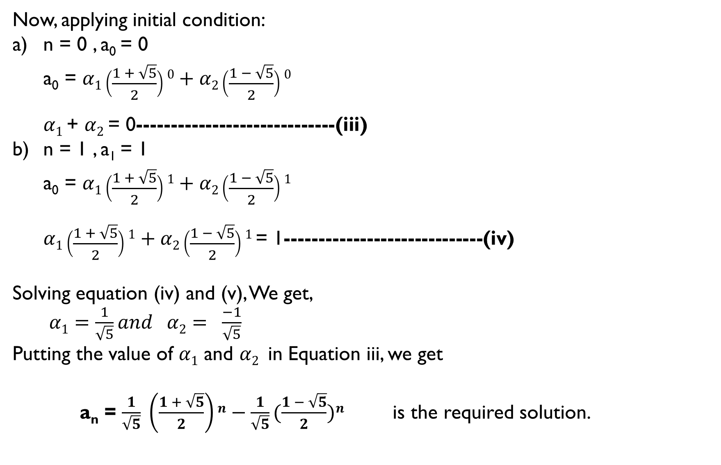
Now, applying initial condition:
n = 0 , a₀ = 0
a₀ = $α1\left(\frac{1 + \sqrt{5}}{2}\right)0+α2\left(\frac{1 − \sqrt{5}}{2}\right)0$
$α1$ + $α2$ = 0-----------------------------(iii)
n = 1 , a₁ = 1
a₀ = $α1\left(\frac{1 + \sqrt{5}}{2}\right)1+α2\left(\frac{1 − \sqrt{5}}{2}\right)1$
$α1\left(\frac{1 + \sqrt{5}}{2}\right)1+α2\left(\frac{1 − \sqrt{5}}{2}\right)1$= 1-----------------------------(iv)
Solving equation (iv) and (v), We get,
$α1=\frac{1}{\sqrt{5}}and α2= \frac{−1}{\sqrt{5}}$
Putting the value of $α1$ and $α2$in Equation iii, we get
a_{n} = $\frac{1}{\sqrt{5}} \left(\frac{1 + \sqrt{5}}{2}\right)n−\frac{1}{\sqrt{5}}(\frac{1 − \sqrt{5}}{2})n$ is the required solution.

Slide 13
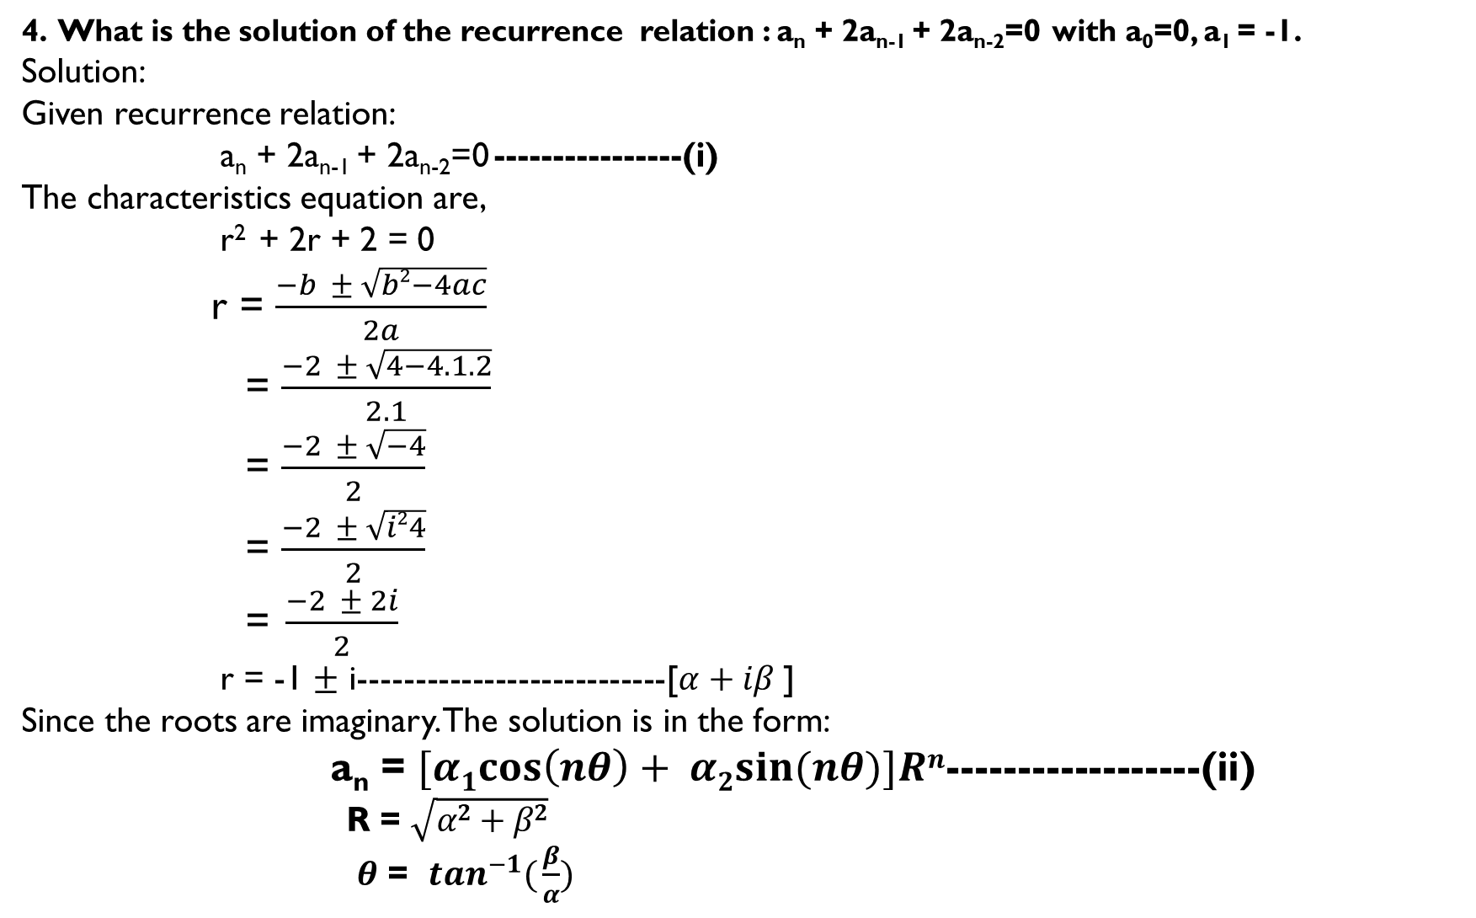
4. What is the solution of the recurrence relation : a_{n} + 2a_{n-1} + 2a_{n-2}=0 with a₀=0, a₁ = -1.
Solution:
Given recurrence relation:
a_{n} + 2a_{n-1} + 2a_{n-2}=0 ----------------(i)
The characteristics equation are,
r² + 2r + 2 = 0
r = $\frac{−b ± \sqrt{b2−4ac}}{2a}$
= $\frac{−2 ± \sqrt{4−4.1.2}}{2.1}$
= $\frac{−2 ± \sqrt{−4}}{2}$
= $\frac{−2 ± \sqrt{i24}}{2}$
= $\frac{−2 ± 2i}{2}$
r = -1 $±$ i---------------------------[$α+iβ$]
Since the roots are imaginary. The solution is in the form:
a_{n} = $[α1cos\left(nθ\right)+ α2sin{(nθ})]Rn$------------------(ii)
R = $\sqrt{α2+β2}$
$θ$ = $\tan^{−1}({\frac{β}{α})}$

Slide 14
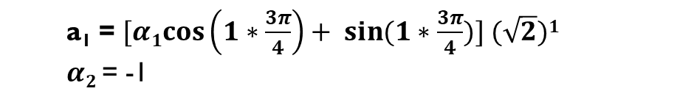
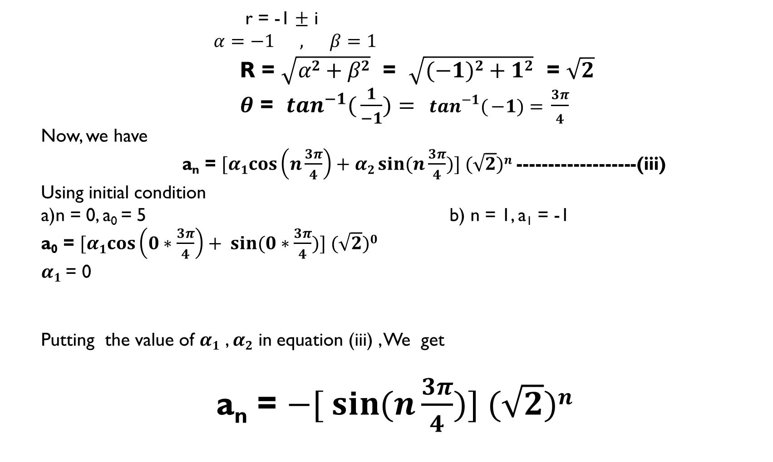
r = -1 $±$ i
$α=−1 , β=1$
R = $\sqrt{α2+β2}$ = $\sqrt{(−1)2+12}$ = $\sqrt{2}$
$θ$ = $\tan^{−1}({\frac{1}{−1})= } \tan^{−1}({−1)= }\frac{3π}{4}$
Now, we have
a_{n} = $[α1cos\left(n\frac{3π}{4}\right)+α2\sin{(n\frac{3π}{4}})] (\sqrt{2})n$-------------------(iii)
Using initial condition
a)n = 0, a₀ = 5 b) n = 1, a₁ = -1
a₀ = $[α1cos\left(0∗\frac{3π}{4}\right)+ \sin{(0∗\frac{3π}{4}})] (\sqrt{2})0$
$α1$= 0
Putting the value of $α1$ , $α2$ in equation (iii) , We get
a_{n} = $−[ \sin{(n\frac{3π}{4}})] (\sqrt{2})n$
a₁ = $[α1cos\left(1∗\frac{3π}{4}\right)+ \sin{(1∗\frac{3π}{4}})] (\sqrt{2})1$
$α2$= -1

Slide 15
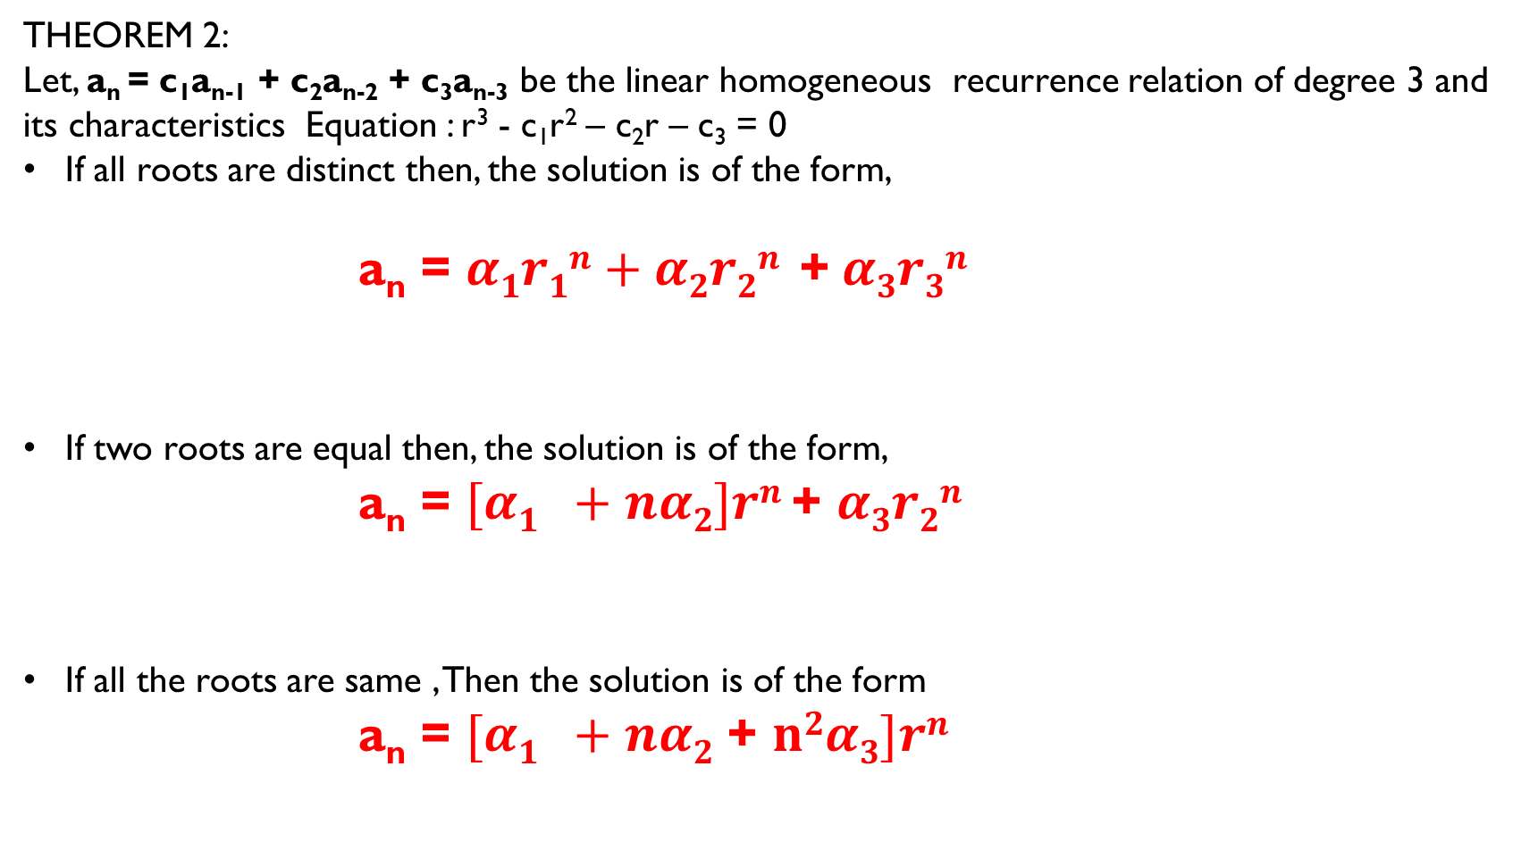
Solution of Linear homogeneous recurrence relation:
THEOREM 2:
Let, a_{n} = c₁a_{n-1} + c₂a_{n-2} + c₃a_{n-3} be the linear homogeneous recurrence relation of degree 3 and its characteristics Equation : r³ - c₁r² – c₂r – c₃ = 0
If all roots are distinct then, the solution is of the form,
a_{n} = $α1r1n+α2r2n$ +$α3r3n$
If two roots are equal then, the solution is of the form,
a_{n} = $[α1 +nα2]rn$ + $α3r2n$
If all the roots are same , Then the solution is of the form
a_{n} = $[α1 +nα2$ + $n2α3]rn$

Slide 16
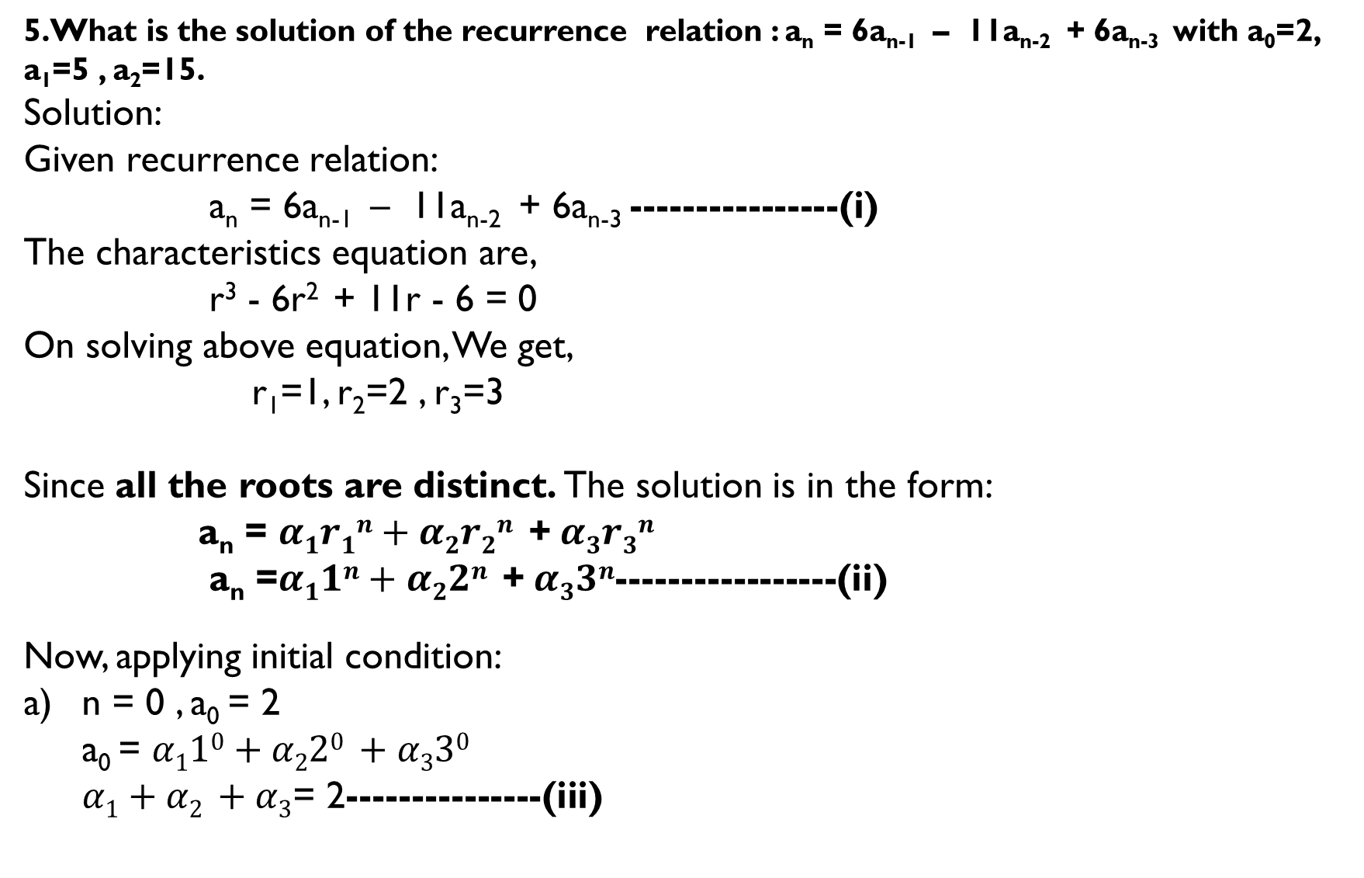
5.What is the solution of the recurrence relation : a_{n} = 6a_{n-1} – 11a_{n-2} + 6a_{n-3} with a₀=2, a₁=5 , a₂=15.
Solution:
Given recurrence relation:
a_{n} = 6a_{n-1} – 11a_{n-2} + 6a_{n-3} ----------------(i)
The characteristics equation are,
r³ - 6r² + 11r - 6 = 0
On solving above equation, We get,
r₁=1, r₂=2 , r₃=3
Since all the roots are distinct. The solution is in the form:
a_{n} = $α1r1n+α2r2n$ +$α3r3n$
a_{n} =$α11n+α22n \text{+} α33n$-----------------(ii)
Now, applying initial condition:
n = 0 , a₀ = 2
a₀ = $α110+α220 +α330$
$α1+α2 +α3$= 2---------------(iii)

Slide 17
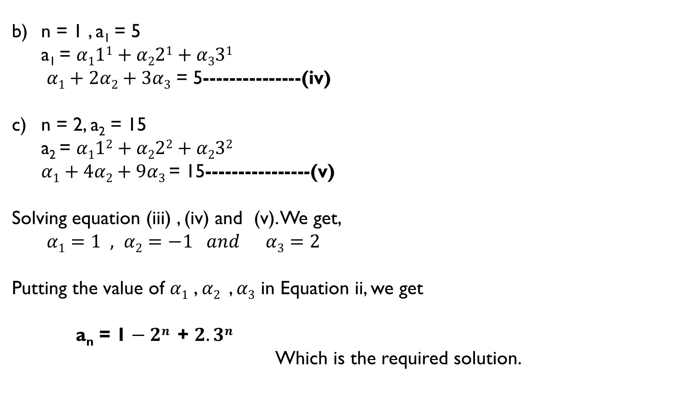
b) n = 1 , a₁ = 5
a₁ = $α111+α221+α331$
$α1+2α2+3α3$ = 5---------------(iv)
n = 2, a₂ = 15
a₂ = $α112+α222+α232$
$α1+4α2+9α3$ = 15----------------(v)
Solving equation (iii) , (iv) and (v). We get,
$α1=1 , α2=−1 and α3=2$
Putting the value of $α1$ , $α2$, $α3$in Equation ii, we get
a_{n} = 1$− 2n \text{+} 2.3n$
Which is the required solution.

Slide 18
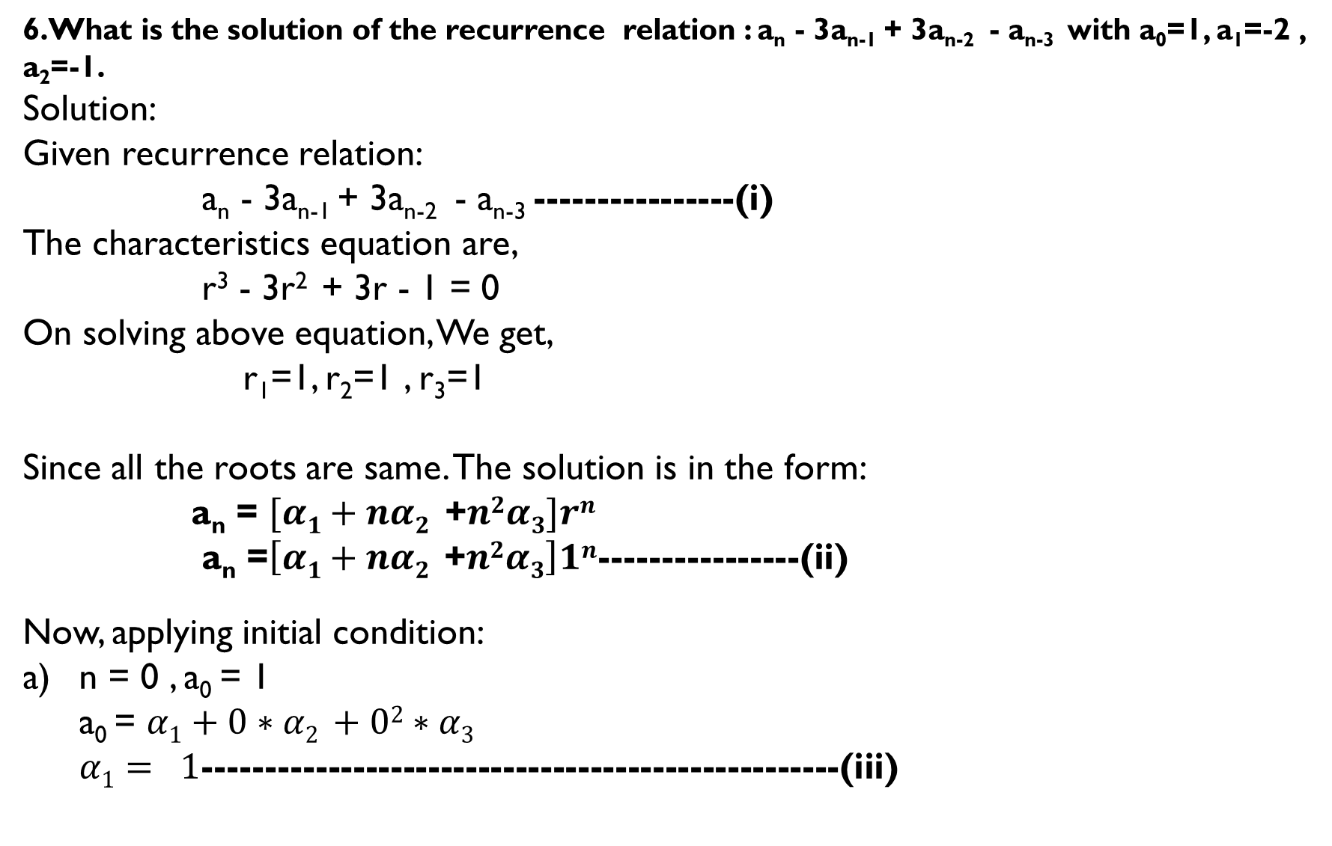
6.What is the solution of the recurrence relation : a_{n} - 3a_{n-1} + 3a_{n-2} - a_{n-3} with a₀=1, a₁=-2 , a₂=-1.
Solution:
Given recurrence relation:
a_{n} - 3a_{n-1} + 3a_{n-2} - a_{n-3} ----------------(i)
The characteristics equation are,
r³ - 3r² + 3r - 1 = 0
On solving above equation, We get,
r₁=1, r₂=1 , r₃=1
Since all the roots are same. The solution is in the form:
a_{n} = $[α1+nα2$ +$n2α3]rn$
a_{n} =$\left[α1+nα2 \text{+}n2α3\right]1n$----------------(ii)
Now, applying initial condition:
n = 0 , a₀ = 1
a₀ = $α1+0∗α2 +02∗α3$
$α1= 1$---------------------------------------------------(iii)

Slide 19
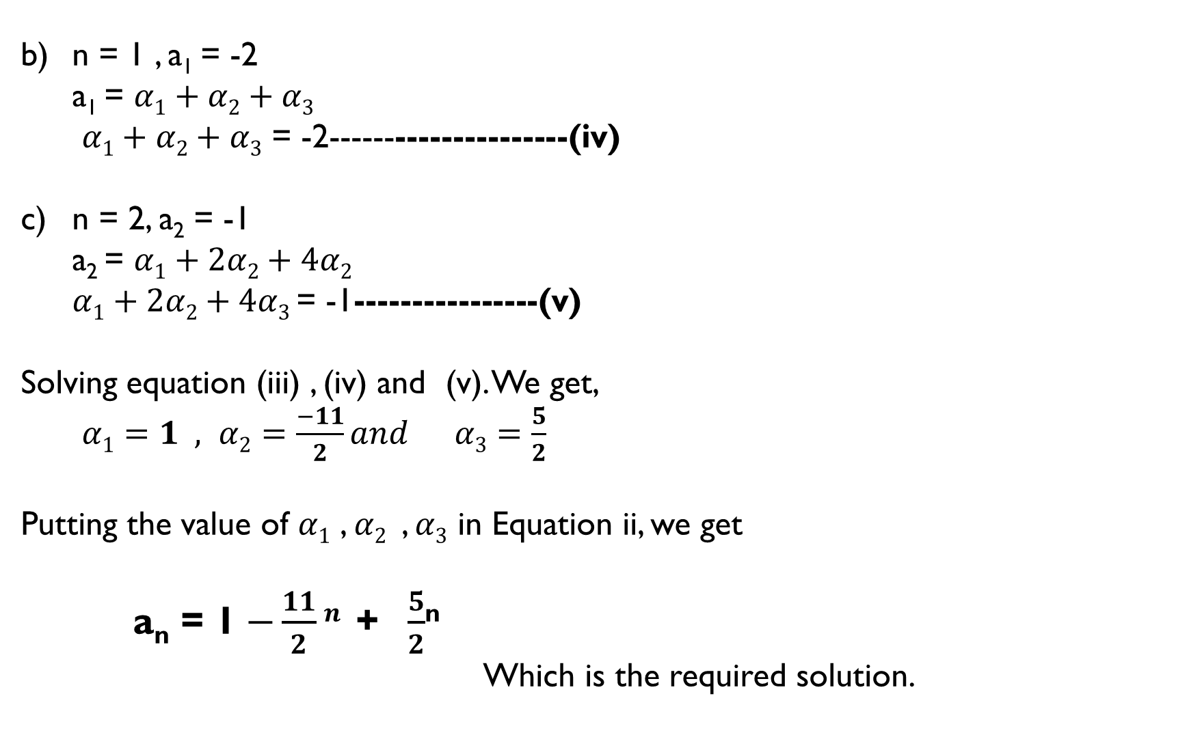
b) n = 1 , a₁ = -2
a₁ = $α1+α2+α3$
$α1+α2+α3$ = -2---------------------(iv)
n = 2, a₂ = -1
a₂ = $α1+2α2+4α2$
$α1+2α2+4α3$ = -1----------------(v)
Solving equation (iii) , (iv) and (v). We get,
$α1=1 , α2=\frac{−11}{2}and α3=\frac{5}{2}$
Putting the value of $α1$ , $α2$, $α3$in Equation ii, we get
a_{n} = 1$−\frac{11}{2}n \text{+} \frac{5}{2}$^{n}
Which is the required solution.

Slide 20
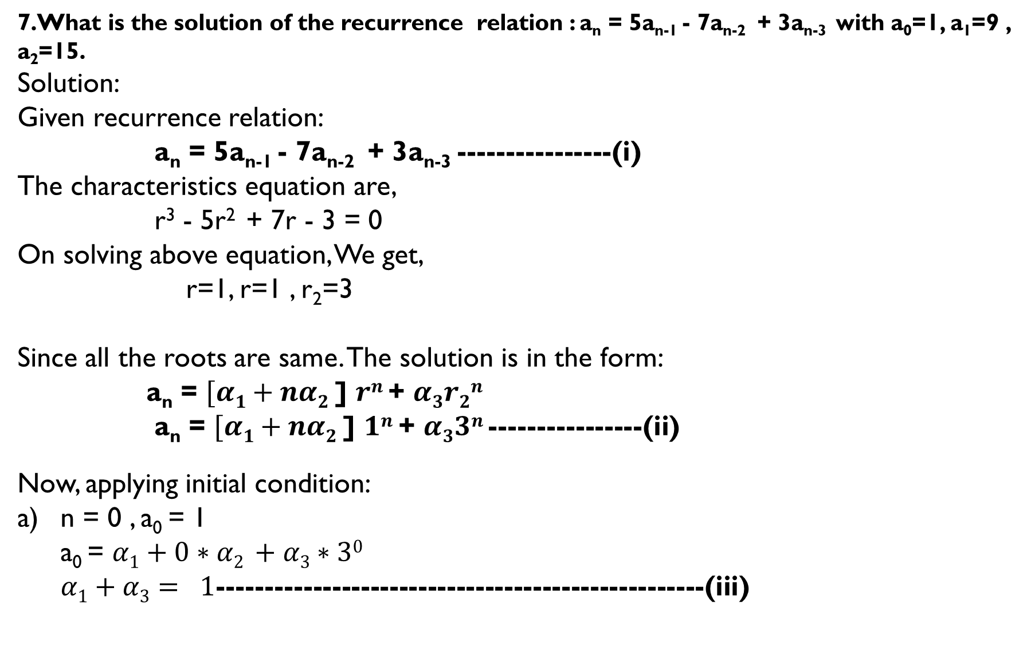
7.What is the solution of the recurrence relation : a_{n} = 5a_{n-1} - 7a_{n-2} + 3a_{n-3} with a₀=1, a₁=9 , a₂=15.
Solution:
Given recurrence relation:
a_{n} = 5a_{n-1} - 7a_{n-2} + 3a_{n-3} ----------------(i)
The characteristics equation are,
r³ - 5r² + 7r - 3 = 0
On solving above equation, We get,
r=1, r=1 , r₂=3
Since all the roots are same. The solution is in the form:
a_{n} = $[α1+nα2$ ] $rn$ + $α3r2n$
a_{n} = $[α1+nα2$ ] $1n$ + $α33n$----------------(ii)
Now, applying initial condition:
n = 0 , a₀ = 1
a₀ = $α1+0∗α2 +α3∗30$
$α1+α3= 1$---------------------------------------------------(iii)

Slide 21
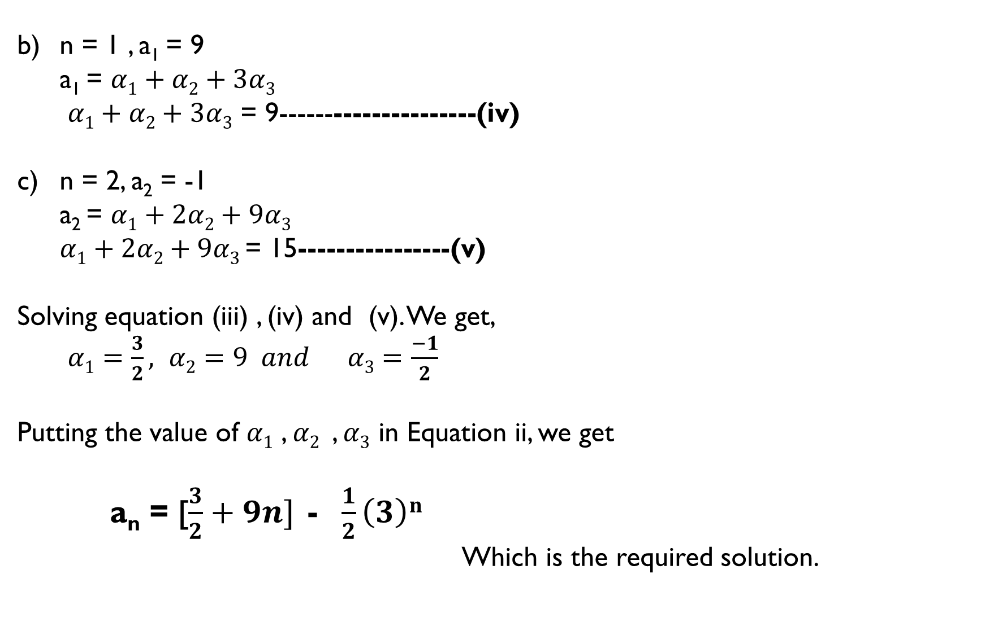
b) n = 1 , a₁ = 9
a₁ = $α1+α2+3α3$
$α1+α2+3α3$ = 9---------------------(iv)
n = 2, a₂ = -1
a₂ = $α1+2α2+9α3$
$α1+2α2+9α3$ = 15----------------(v)
Solving equation (iii) , (iv) and (v). We get,
$α1=\frac{3}{2}, α2=9 and α3=\frac{−1}{2}$
Putting the value of $α1$ , $α2$, $α3$in Equation ii, we get
a_{n} = [$\frac{3}{2}+9n] \text{− }\frac{1}{2}\left(3\right)n$
Which is the required solution.

